Slide 1


Events

Slide 2
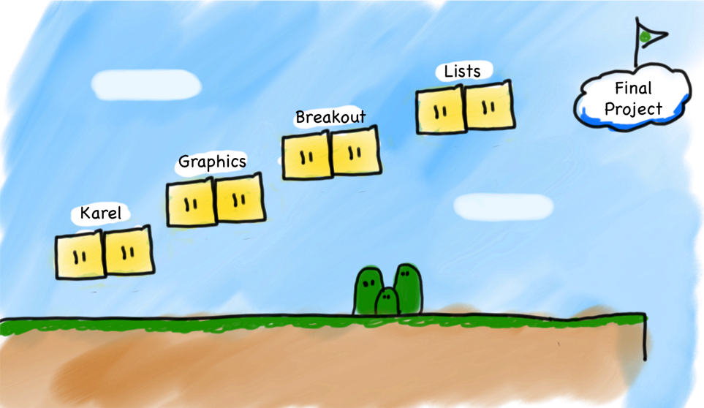
Where are we?

Slide 3
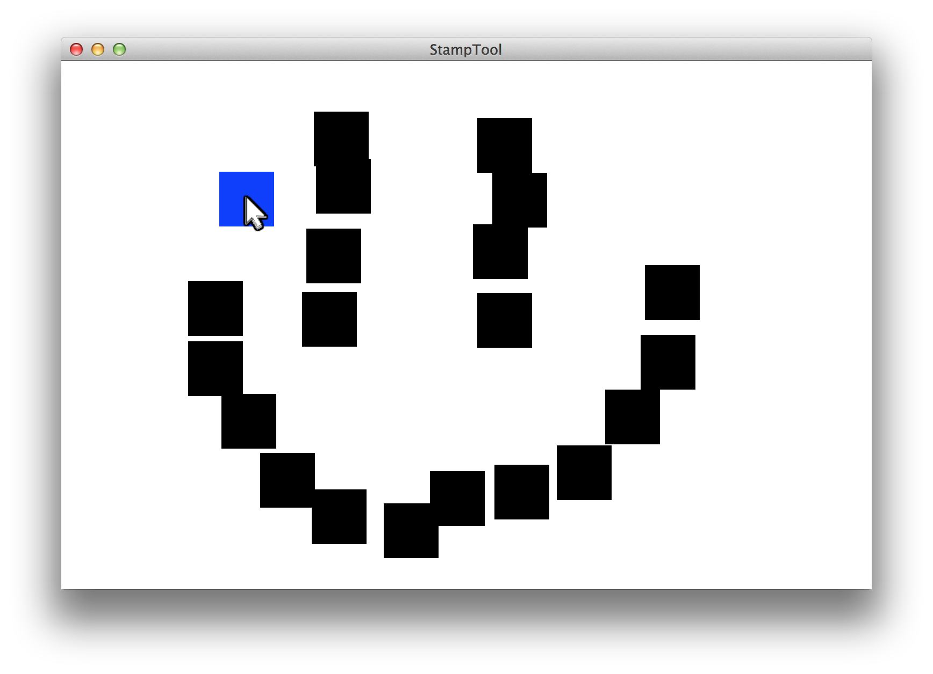
Stamp Tool

Slide 4
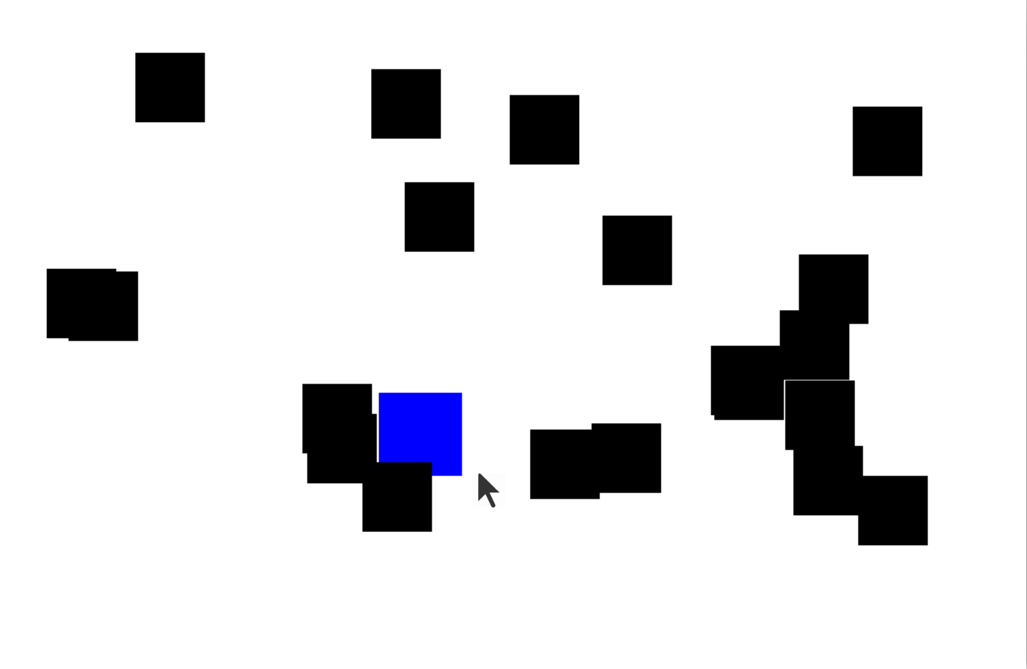
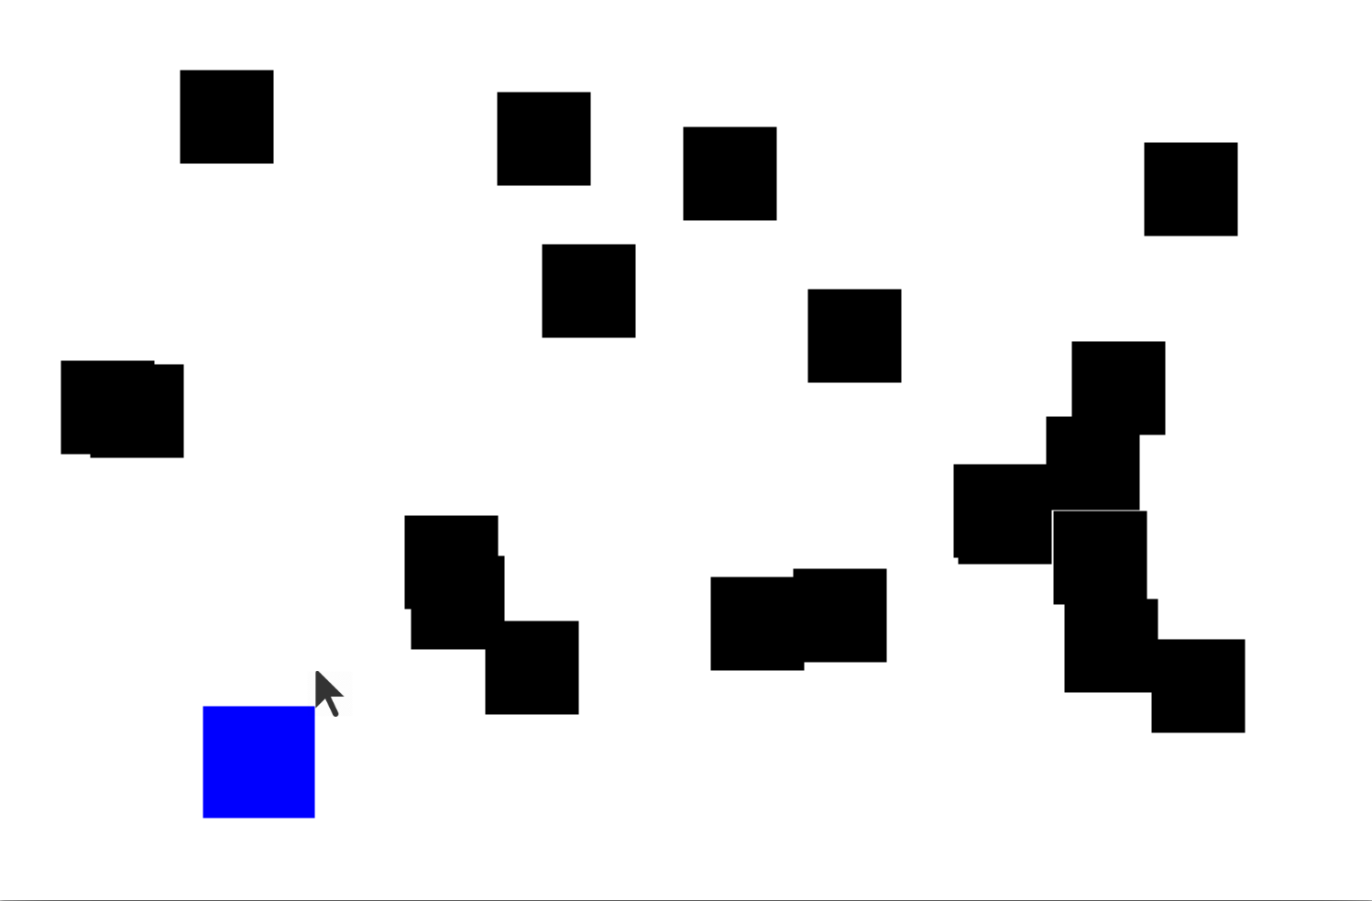
Catch Me If You Can

Slide 5
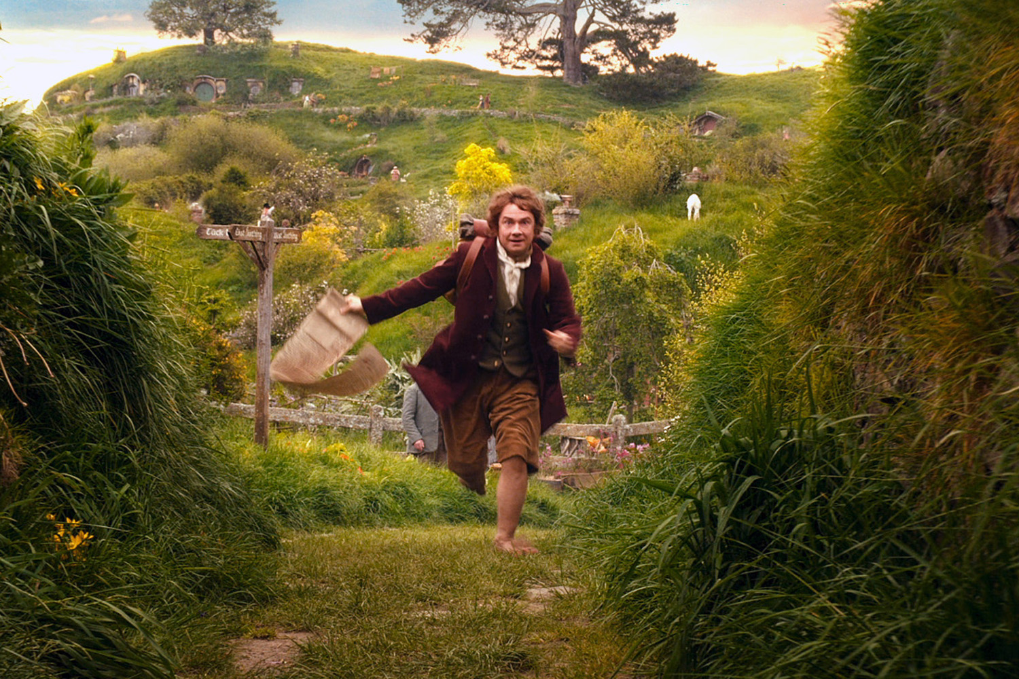
We’ve Gotten Ahead of Ourselves
Source: The Hobbit

Slide 6
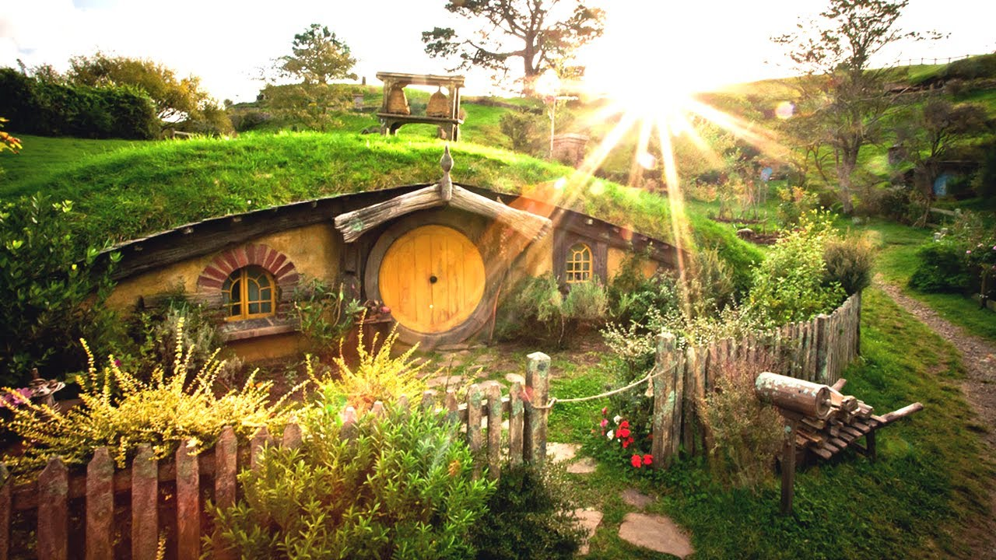
Start at the Beginning
Source: The Hobbit

Slide 7

Learning Goals
Write a program that can respond to mouse events
Use an instance variable in your program

Slide 8
Listener Model
When users interact with computer they generate events (e.g., moving/clicking the mouse)
Can respond to events by having listener for events
addMouseListeners()
Listeners get control of the program when an event happens.
Using portions of slides by Eric Roberts

Slide 9
Responding to Mouse Events
1. The run method should call addMouseListeners
2. Write definitions of any listener methods needed
mouseClicked( e)
Called when the user clicks the mouse
mousePressed( e)
Called when the mouse button is pressed
mouseReleased(e)
Called when the mouse button is released
mouseMoved(e)
Called when the user moves the mouse
mouseDragged(e)
Called when the mouse is dragged with
the button down
The parameter e is MouseEvent object, which provides more data about event, such as the location of mouse.
Using portions of slides by Eric Roberts

Slide 10
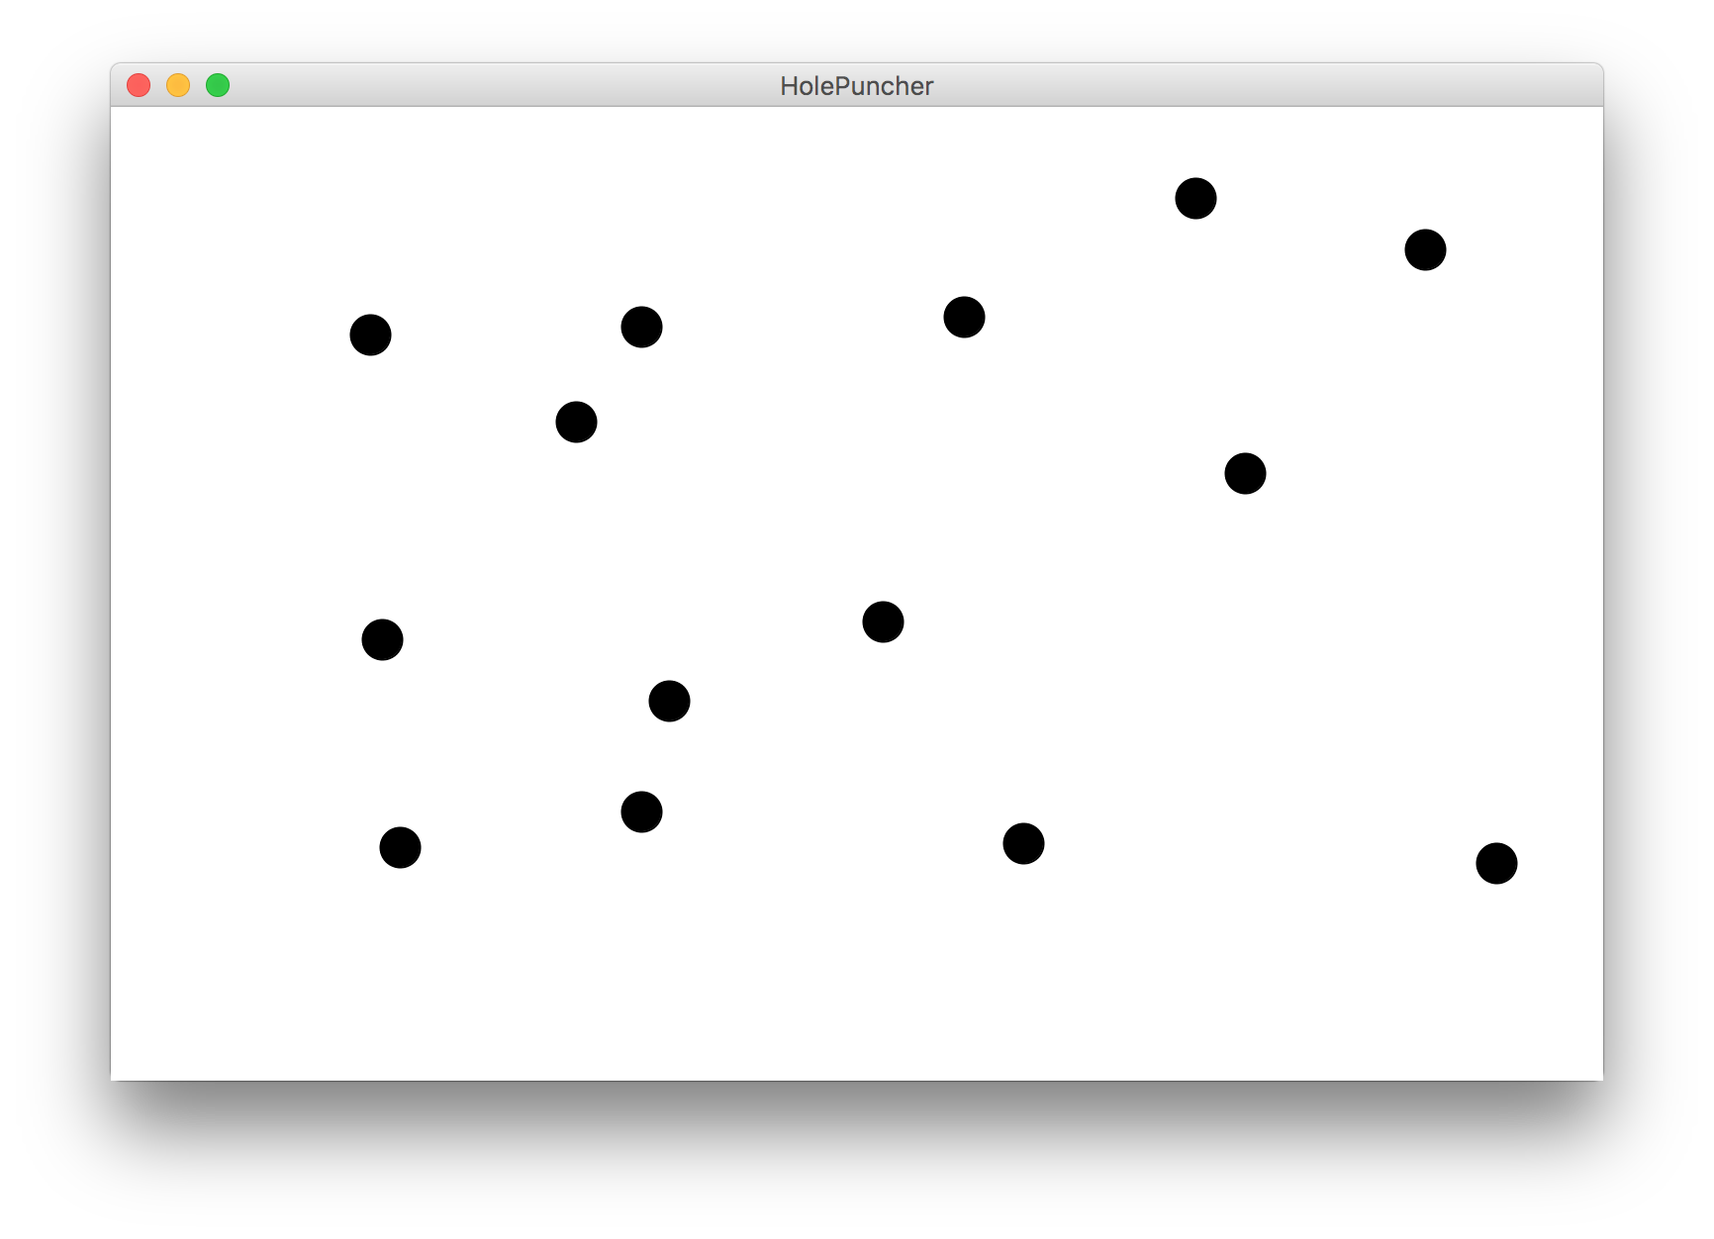
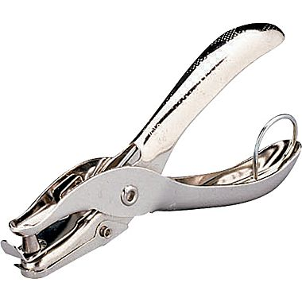
Hole Puncher

Slide 11
Now With Dancing Children

Slide 12

Normal Program
Run Method

Slide 13
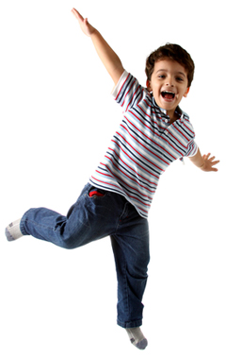
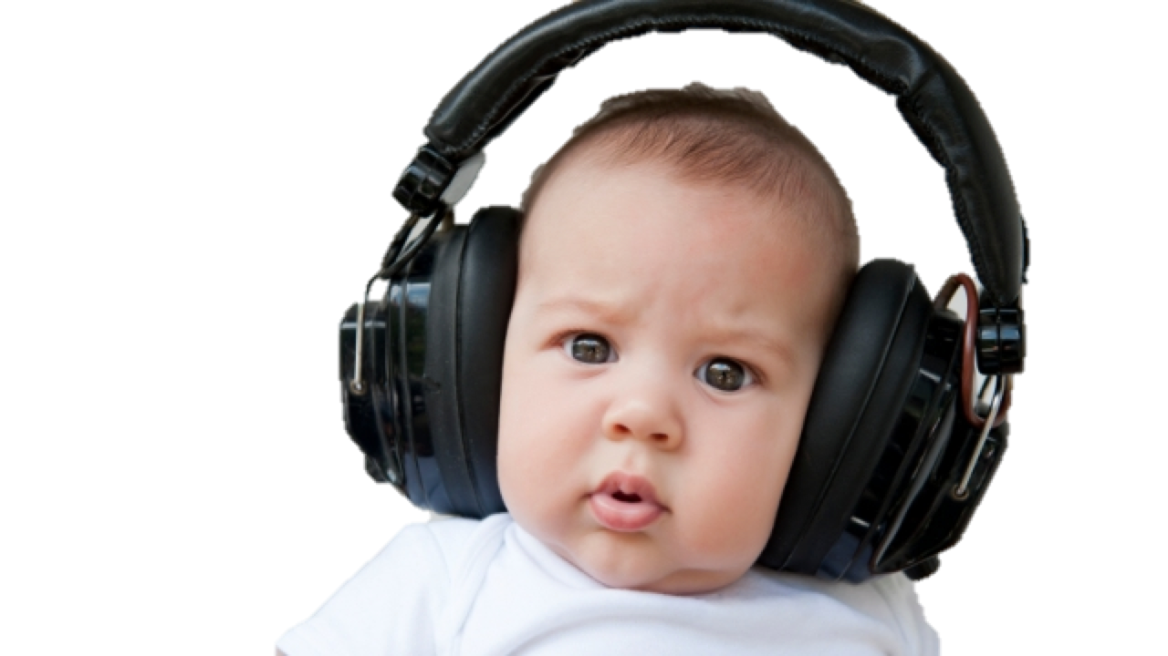
New Listener Characters
Mouse Listener
Mouse Clicked Method

Slide 14
Program Starts Running
Run Method
Mouse Clicked Method

Slide 15
Add Mouse Listener
Run Method
Mouse Clicked Method
Mouse Listener
addMouseListeners();

Slide 16
Program Runs as Usual
Run Method
Mouse Clicked Method
Mouse Listener

Slide 17

Mouse Clicked!
Run Method
Mouse Clicked Method
Mouse Listener

Slide 18
Calls Mouse Clicked Method
Run Method
Mouse Clicked Method
Mouse Listener

Slide 19
When done, Run continues.
Run Method
Mouse Clicked Method
Mouse Listener

Slide 20
Keeps Doing Its Thing…
Run Method
Mouse Clicked Method
Mouse Listener

Slide 21
Mouse Moved!
Run Method
Mouse Clicked Method
Mouse Listener

Slide 22
Calls Mouse Clicked Method
Run Method
Mouse Clicked Method
Mouse Listener

Slide 23
When done, Run continues.
Run Method
Mouse Clicked Method
Mouse Listener

Slide 24

Mouse Tracker

Slide 25
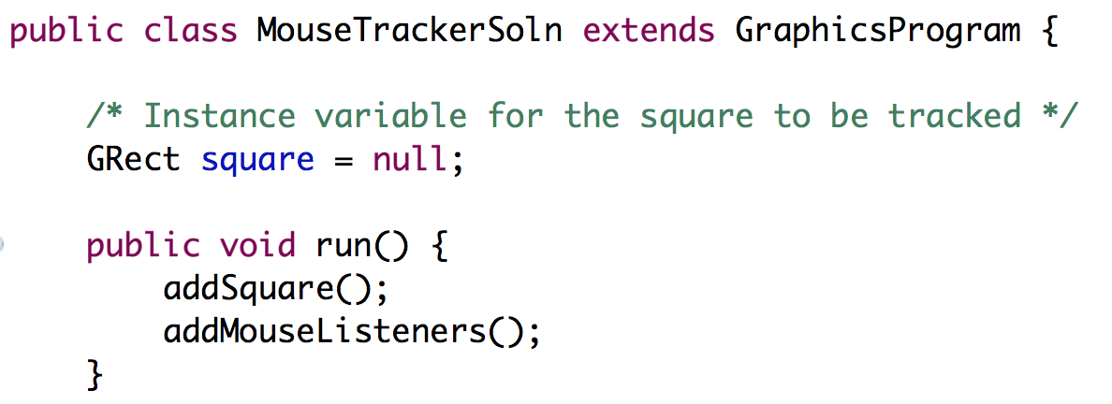
Instance Variables
Variables exist until their inner-most code block ends.
If a variable is defined outside all methods, its inner-most code block is the entire program!
We call these variables instance variables
* Instance variables have special meanings in programs with multiple files. For now you need to know that all methods can see them and that their initialization line is executed before run.

Slide 26
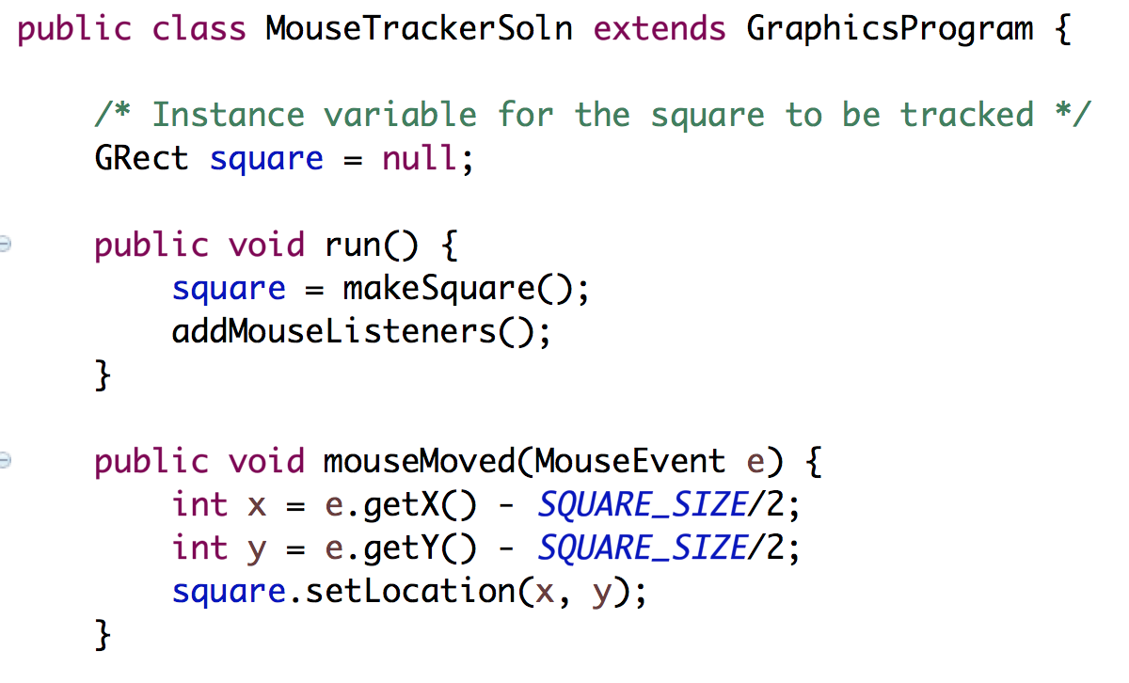
Instance Variables + Events
Often you need instance variables to pass information between the run method and the mouse event methods!

Slide 27
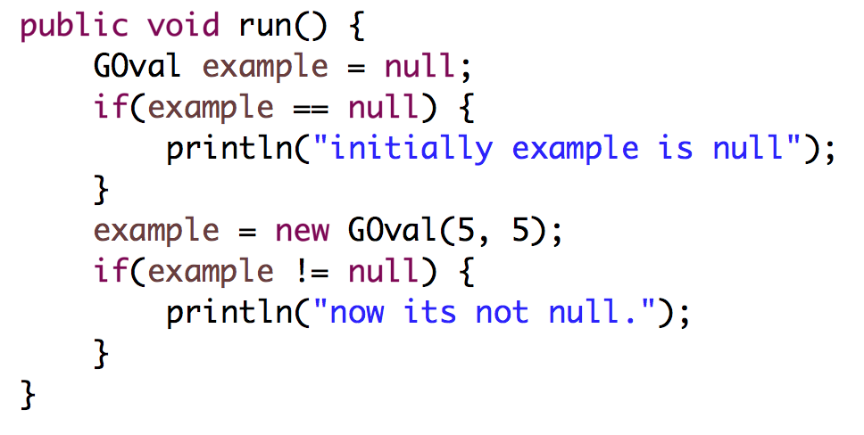
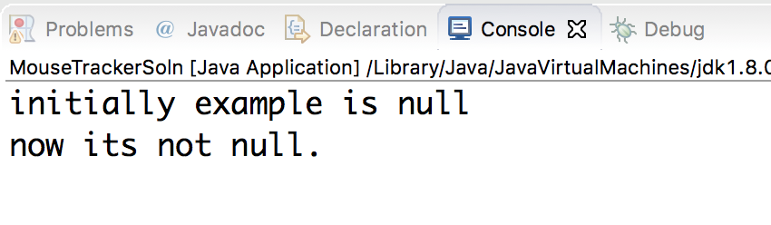
Null
Objects have a special value called null which means this variable is not associated with a value yet.

Slide 28
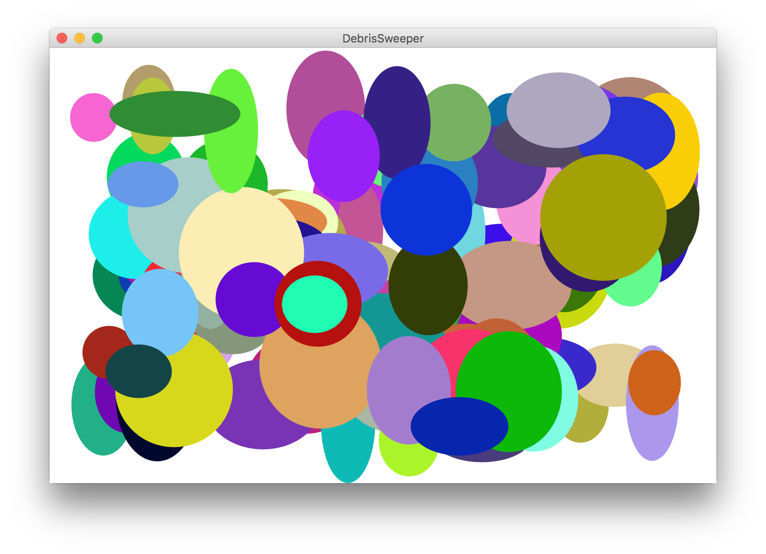
Debris Sweeper

Slide 29
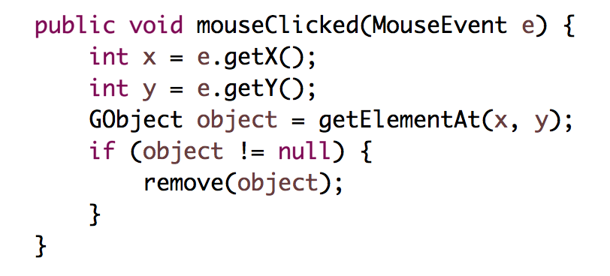
getElementAt(x, y);
getElementAt(x, y) will return any GObject at the (x, y) coordinates. It will return null if there is no object at those coordinates.

Slide 30
And Here We Are…

Slide 31
Stamp Tool

Slide 32
New Concepts
New Commands
addMouseListeners();
getElementAt(x, y);
New Ideas
The Listener Model
Instance Variables
null

Slide 33
Responding to Mouse Events
1. The run method should call addMouseListeners
2. Write definitions of any listener methods needed
mouseClicked( e)
Called when the user clicks the mouse
mousePressed( e)
Called when the mouse button is pressed
mouseReleased(e)
Called when the mouse button is released
mouseMoved(e)
Called when the user moves the mouse
mouseDragged(e)
Called when the mouse is dragged with
the button down
The parameter e is MouseEvent object, which provides more data about event, such as the location of mouse.
Using portions of slides by Eric Roberts

Slide 34
Responding to Keyboard Events
1. The run method should call addKeyListeners
2. Write definitions of any listener methods needed
keyPressed( e)
Called when the user presses a key
keyReleased( e)
Called when the key comes back up
keyTyped(e)
Called when the user types
(presses and releases) a key
The parameter e is a KeyEvent object, which indicates which key is involved.
Using portions of slides by Eric Roberts

Slide 35

Warm Up: Making Tracks

Slide 36
Catch Me If You Can?

